Slide 1
What is BSD?
Why should you care?

Slide 2
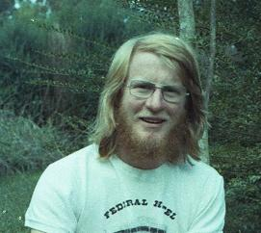
Who Am I?
Wrote my first program in Fortran in 1971
Joined the industry full time in 1976
Have worked as
Component level repair technician
National technical support
National Support and Training Manager
Product Manager
Systems Engineering Manager
Corporate Evangelist
Security Program Manager
Security Strategist
Country Manager

Slide 3
Some UNIX history
Assuming most are familiar with the birth and initial development story
V4 was the first version with wide distribution
Source code recently found at University of Utah

Slide 4
SRI
Utah
MIT
Linc.
UCSB
SDC
UCLA
Rand
BBN
Harv.
ARPA network 1970
Telecommunications and the Computer, James Martin, 1976
Notes:
Fist four nodes were UCLA, UCSB, SRI, UofUtah

Slide 5
Univac St Paul
SRI
LBL
Utah
III
MIT
Ames TIP
CCA
Univ. Hawaii (satellite)
BBN
Ames IMP
NYU
Aberdeen.
Harv.
X-PARC
Stanford
NBS.
LL
FNWC
ETAC
Tinker
AFETR
SCRL
ARPA
UCSB
Rand
RADC
Mitre
CHI
USCD
Keller Norway (satellite)
SAAC
Belvoir
CMU
SDC
USC
UCLA
NOAA
AFGWC
Case
ARPA network 1974
Telecommunications and the Computer, James Martin, 1976

Slide 6
Some UNIX history
Assuming most are familiar with the birth and initial development story
V4 was the first version with wide distribution
Source code recently found at University of Utah
V6 had broad distribution
Ken Thompson installed V6 at Berkeley while on sabbatical

Slide 7
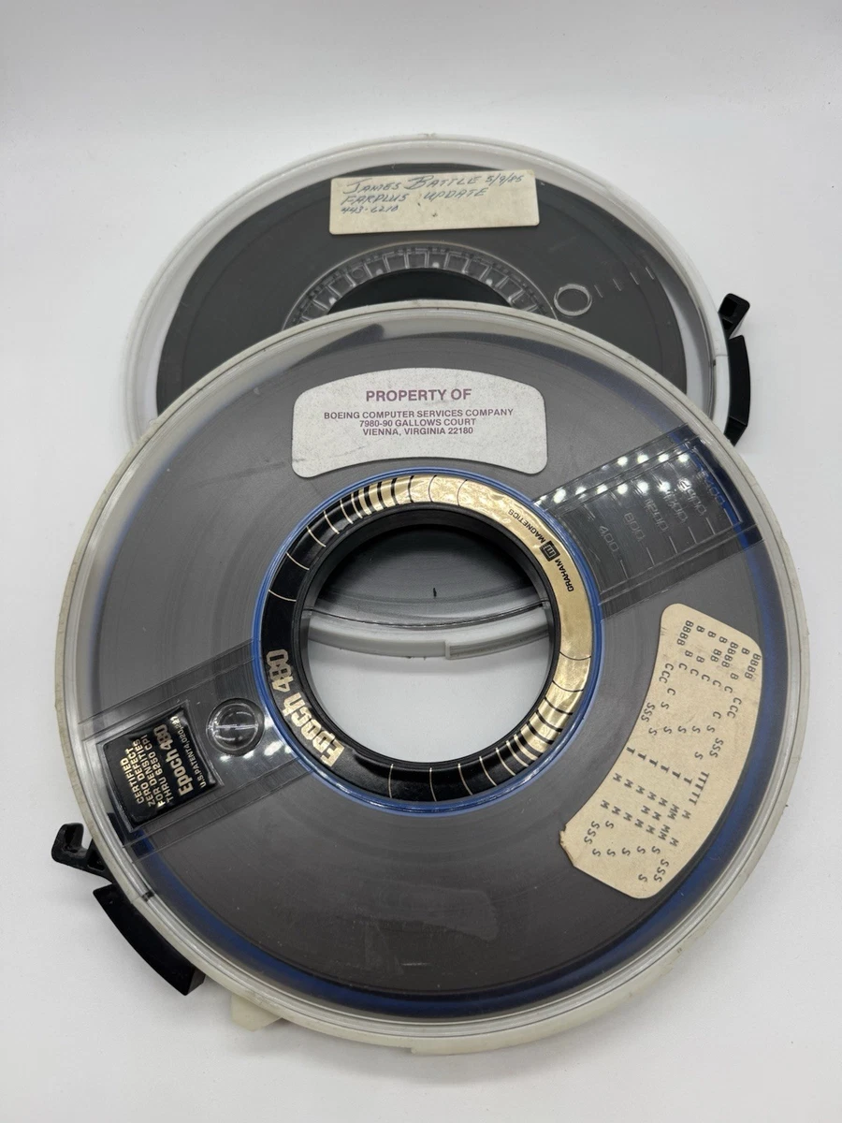
Some UNIX history
Assuming most are familiar with the birth and initial development story
V4 was the first version with wide distribution
Source code recently found at University of Utah
V6 had broad distribution
Ken Thompson installed V6 at Berkeley while on sabbatical

Slide 8
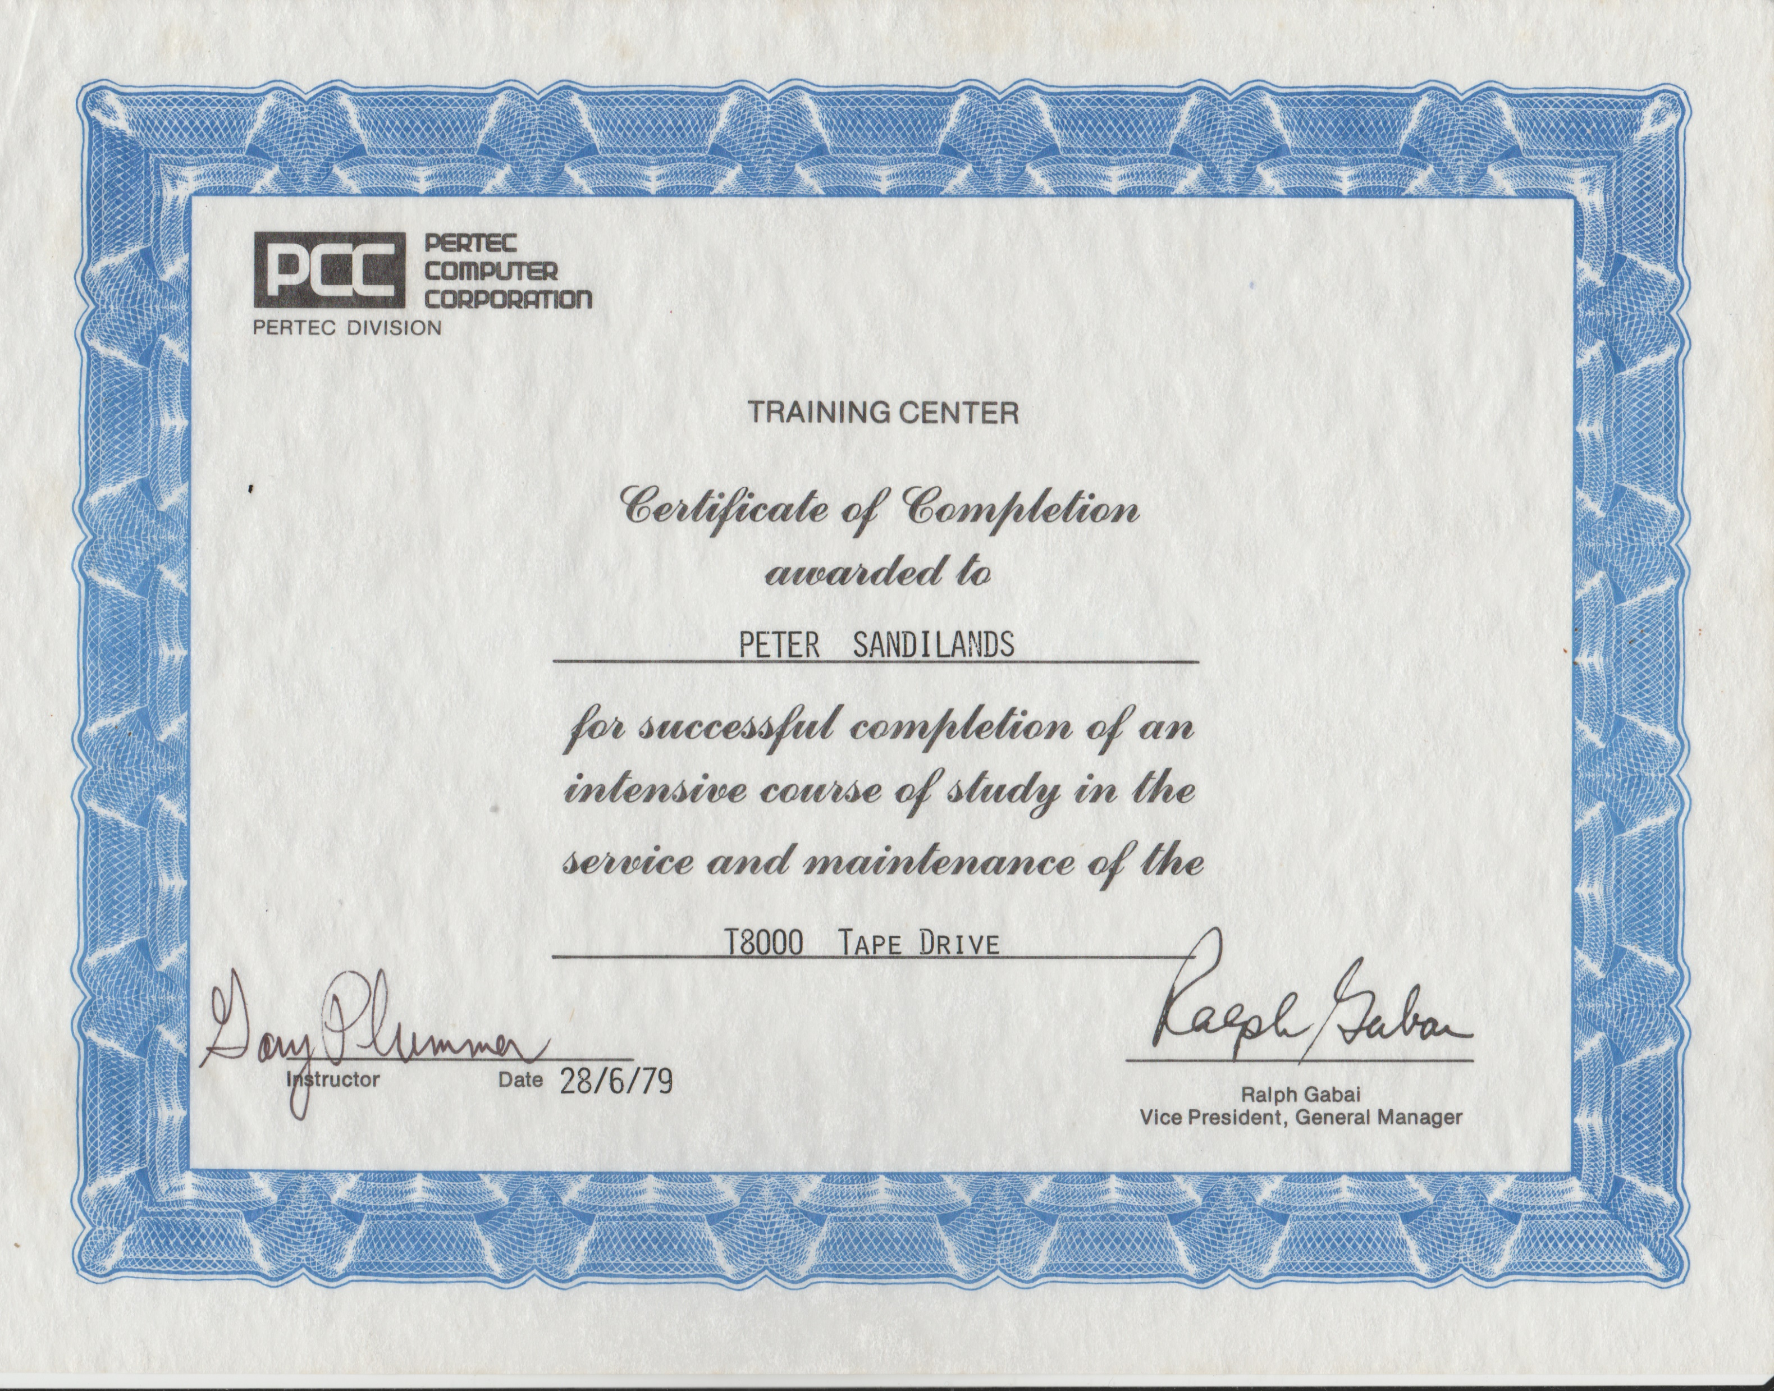
Some UNIX history
Assuming most are familiar with the birth and initial development story
V4 was the first version with wide distribution
Source code recently found at University of Utah
V6 had broad distribution
Ken Thompson installed V6 at Berkeley while on sabbatical

Slide 9
Australian involvement?

Slide 10
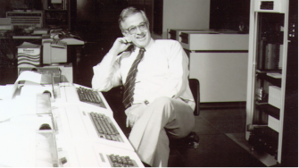
UNSW
Obtained a license and source code for v4 in late 1973
Updated to V6 on its release
Used a PDP11/40 to both use and teach UNIX

Slide 11
Australian Unix Users Group - AUUG
Started in 1975
2nd user group worldwide
Beaten by Usenix by a couple of months
Published a newsletter from late 1978
AUUGN

Slide 12
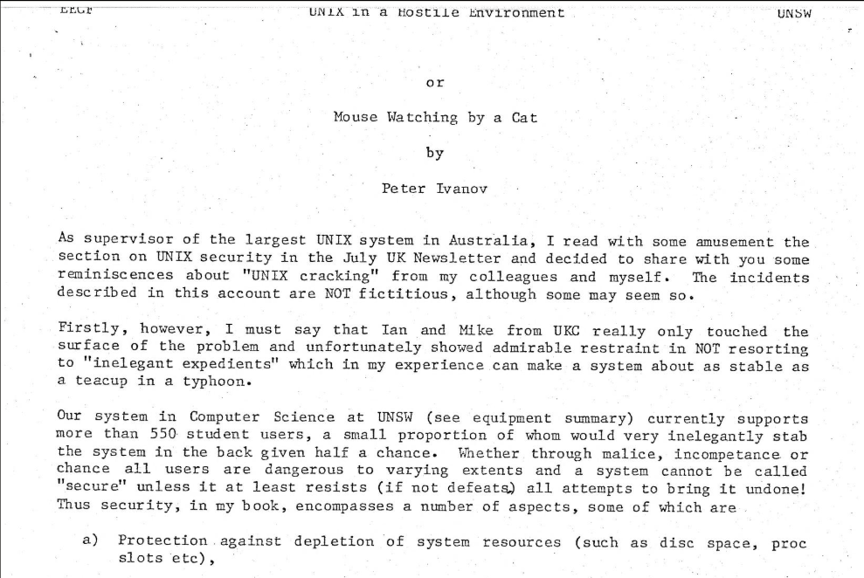
Australian Unix Users Group - AUUG
Started in 1975
2nd user group worldwide
Beaten by Usenix by a couple of months
Published a newsletter from late 1978
AUUGN

Slide 13
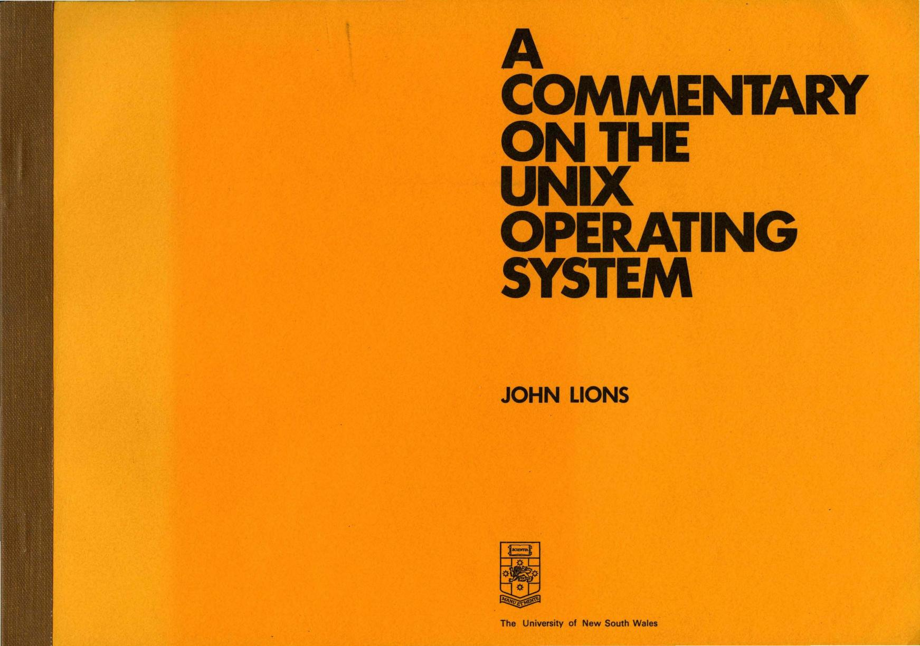
Lions caused chaos

Slide 14
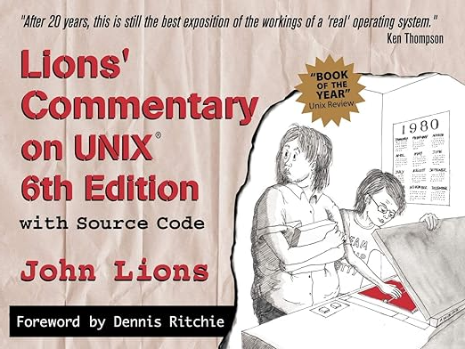
A legal version
Published in 1998
Still relevant

Slide 15

2006 sponsored by alumni

Slide 16

University of Wollongong

Slide 17
University of Wollongong
Three academics, Juris Reinfelds, Richard Miller and Ross Nealon are credited with the fist port of UNIX to an Interdata system. The first successful port of any computer operating system

Slide 18
University of Calironia, Berkeley -UCB
Computer Science Research Group (CSRG)
Berkeley acquired a V4 license in 1974- PDP 11/45 (shared!)
Ken Thompson, on sabbatical, helped install V6 on a PDP 11/70
Bill Joy writes some basic add-ons
Compiled as 1BSD March 1978

Slide 19
BSD evolution
2BSD in May ‘79
Adds vi and csh
Still just add-ons, needed a V6 license as well
3BSD late ‘79
Included a kernel based on a VAX port

Slide 20
1980s – UNIX commercialisation
Vendors could port and ship UNIX (V7)
Could NOT call it UNIX
Berkeley CSRG continued work on BSD working up 4 BSD in several versions
AT&T released SYSIII and SYSV

Slide 21
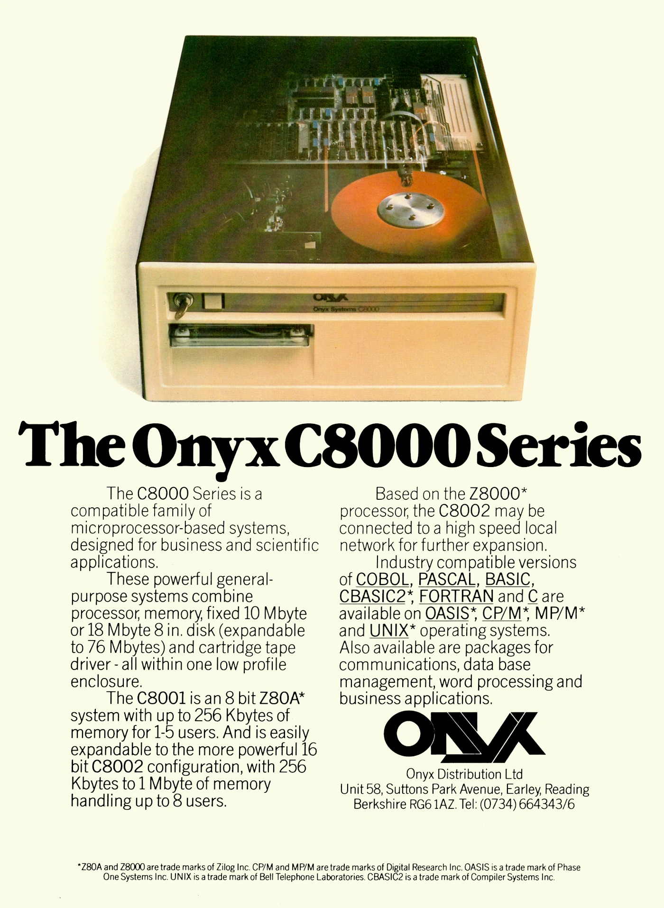
Possibly first microcomputer port
Released in 1980 ONIX was V7
Z8002
Sold ‘00s to AT&T as office document production and management systems

Slide 22
Lawyers at 30 paces
NET2 is released
2 projects take this base to build Intel 386 versions
BSD/ O/S by BSDI
386BSD by Jolitz
USL fires the shot that halted these projects
1994 with Berkeley mostly winning
3 files removed
AT&T copyright added to 70

Slide 23
Berkeley exits stage left
4.4BSD released
4.4BSD Lite, then Lite 2
CSRG disbanded
What we know as BSD based o/s evolved as open source from 4.4BSD Lite 2

Slide 24
BSD Development moves forward
Copyright <YEAR> <COPYRIGHT HOLDER>
Redistribution and use in source and binary forms, with or without modification, are permitted provided that the following conditions are met:
Redistributions of source code must retain the above copyright notice, this list of conditions and the following disclaimer.
Redistributions in binary form must reproduce the above copyright notice, this list of conditions and the following disclaimer in the documentation and/or other materials provided with the distribution.
Developed as complete systems
Tightly controlled development
BSD License
Permissive

Slide 25

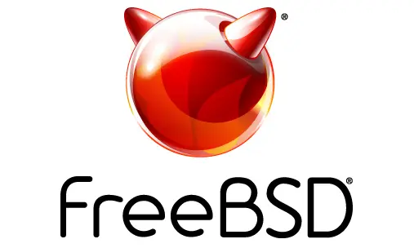

The first BSDs

Slide 26

The first BSDs

Slide 27
FreeBSD supported platforms
Tier 1
x86-64
AArch64 64-bit ARM (ARMv9 and ARMv8)
Tier 2
AArch32 32-bit ARM (ARM-v7 and up)
64-bit POWER 64-bit, bi-endian POWER9 and POWER8
powerpc64 64-bit, big-endian POWER9 through POWER4
RISC-V riscv64 64-bit RISC-V

Slide 28
OpenBSD supported platforms
alpha Digital Alpha-based systems
amd64 AMD64-based systems
arm64 64-bit ARM systems
armv7 ARM-based devices, such as BeagleBone, PandaBoard, CuBox-I etc
hppa Hewlett-Packard Precision Architecture (PA-RISC) systems
i386 Standard PC and clones based on the Intel i386 architecture
landisk IO-DATA Landisk systems (such as USL-5P) based on the SH4 cpu
Loongson Loongson 2E- and 2F-based systems, such as the Lemote Fuloong and Yeeloong, Gdium Liberty, etc.
Luna88k Omron LUNA-88K and LUNA-88K2 workstations
macppc Apple New World PowerPC-based machines, from the iMac onwards
octeon Cavium Octeon-based MIPS64 systems
powerpc64 IBM POWER-based PowerNV systems
riscv64 64-bit RISC-V systems
sparc64 Sun UltraSPARC and Fujitsu SPARC64 systems

Slide 29
NetBSD supported platforms
Tier 1
Port CPU Machines
aarch64 aarch64 64-bit ARM CPUs
amd64 x86_64 64-bit x86-family machines with AMD and Intel CPUs
evbarm arm ARM evaluation boards
evbmips mips MIPS-based evaluation boards
evbppc powerpc PowerPC-based evaluation boards
hpcarm arm StrongARM based Windows CE PDA machines
i386 i386 32-bit x86-family generic machines ("PC clones")
sparc64 sparc Sun UltraSPARC (64-bit)
xen i386, x86_64 Xen Virtual Machine Monitor

Slide 30
NetBSD supported platforms
Tier 2
Port CPU Machines
acorn32 arm Acorn RiscPC/A7000/NC and compatibles
algor mips Algorithmics MIPS evaluation boards
alpha alpha Digital Alpha (64-bit)
amiga m68k Commodore Amiga, MacroSystem DraCo
amigappc powerpc PowerPC-based Amiga boards
arc mips Machines following the Advanced RISC Computing spec
atari m68k Atari TT030, Falcon, Hades
bebox powerpc Be Inc's BeBox
cats arm Chalice Technology's Strong Arm evaluation board
cesfic m68k CES's FIC8234 VME processor board
cobalt mips Cobalt Networks' Microservers
dreamcast sh3 Sega Dreamcast game console
epoc32 arm 32bit PSION EPOC PDA
emips mips Machines based on "Extensible MIPS"
evbsh3 sh3 Evaluation boards with Renesas (Hitachi) Super-H SH3 and SH4 CPUs
ews4800mips mips NEC's MIPS based EWS4800 workstations

Slide 31
NetBSD supported platforms
Tier 2
Port CPU Machines
hp300 m68k Hewlett-Packard 9000/300 and 400 series
hppa hppa Hewlett-Packard 9000/700 series
hpcmips mips MIPS based Windows CE PDA machines
hpcsh sh3 Renesas (Hitachi) SH3 and SH4 based Windows CE PDA machines
ia64 itanium Itanium family of processors none
ibmnws powerpc IBM Network Station Series 1000
iyonix arm Iyonix ARM pc
landisk sh3 SH4 based NAS appliances by I-O DATA
luna68k m68k OMRON Tateisi Electronics' LUNA series
mac68k m68k Apple Macintosh
macppc powerpc Apple Power Macintosh and clones
mipsco mips Mips family of workstations and servers
mmeye sh3 Brains' mmEye Multi Media Server
mvme68k m68k Motorola MVME 68k SBCs
mvmeppc powerpc Motorola MVME PowerPC SBCs
netwinder arm StrongARM based NetWinder machines

Slide 32
NetBSD supported platforms
Tier 2
Port CPU Machines
news68k m68k Sony's m68k based "NET WORK STATION" series
newsmips mips Sony's MIPS based "NET WORK STATION" series
next68k m68k NeXT 68k 'black' hardware
ofppc powerpc Generic OpenFirmware compliant PowerPC machines
pmax mips Digital MIPS-based DECstations and DECsystems
prep powerpc PReP (PowerPC Reference Platform) and CHRP machines
riscv riscv RISC-V none
rs6000 powerpc MCA-based IBM RS/6000 workstations
sandpoint powerpc Motorola Sandpoint reference platform
sbmips mips Broadcom SiByte evaluation boards
sgimips mips Silicon Graphics' MIPS-based workstations
shark arm Digital DNARD ("shark")
sparc sparc Sun SPARC (32-bit)
sun2 m68k Sun 2
sun3 m68k Sun 3 and 3x
vax vax Digital VAX
x68k m68k Sharp X680x0 series
zaurus arm Sharp C7x0/C860/C1000/C3x00 series PDA 10.1

Slide 33
FreeBSD derivatives
ClonOS^{[1]} | Offers a complete web UI for easily controlling, deploying and managing FreeBSD jails, containers and Bhyve/Xen hypervisor virtual environments
DragonFly BSD | Originally forked from FreeBSD 4.8, now developed in a different direction
TrueNAS | Previously known as FreeNAS
GhostBSD | GhostBSD is a FreeBSD OS distro oriented for desktops and laptops.
HardenedBSD | HardenedBSD is a security-enhanced fork of FreeBSD.
helloSystem | A desktop system for creators that focuses on simplicity, elegance, and usability
Junos OS | For Juniper routers
MidnightBSD | Midnight BSD forked from FreeBSD 6.1 Beta.

Slide 34
FreeBSD derivatives
XigmaNAS | Previously known as NAS4Free, is a network-attached storage (NAS) server software. It is a continuation of the original FreeNAS code.
NomadBSD | Persistent live system for USB flash drives
OPNsense | OPNsense is a FreeBSD-based firewall tailored for use as a firewall and router forked from pfSense.
pfSense | pfSense is a FreeBSD-based firewall tailored for use as a firewall and router.
CellOS | The PlayStation 3 operating system
Orbis OS | The PlayStation 4 operating system
Zrouter | FreeBSD based firmware for embedded devices
ULBSD | ULBSD is a Unix-like, desktop-oriented operating system based on FreeBSD.

Slide 35
OpenBSD derivatives
ÆrieBSD | OpenBSD fork tends to be free from GPL-licensed s/w.
adJ | Distribution of OpenBSD for Spanish speakers
BowlFish | Customized OpenBSD installation script for embedded systems, intended to make OpenBSD fit into small media like compact flash cards.
BSDanywhere | Live CD featuring the Enlightenment DR17 window manager
FabBSD | OpenBSD fork main application in CNC field, inactive.
FuguIta | Providing both LiveDVD and LiveUSB for i386/amd64/arm64. Highly customizable by user. Tracking errata on OpenBSD-stable.

Slide 36
OpenBSD derivatives
LiveCD OpenBSD | LiveCD OpenBSD gives users a Live CD/DVD bootable distribution There are 3 flavors, one with XFCE, one with MATE desktop and one with KDE.
LiveUSB OpenBSD | LiveUSB OpenBSD is a project started around 2009 for creating OpenBSD based bootable USB flash images. There are 3 variants, one with Gnome, a minimal text only version and an XFCE desktop image.
MarBSD | LiveCD of OpenBSD
MicroBSD | Fork of OpenBSD 3.0, begun in July 2002. to produce a free and fully secure, complete system, but with a small footprint.
PsygNAT | Firewall and NAT router tool
SecBSD | OS for cybersecurity professionals, ethical hackers, and penetration testers. Comparable to Kali Linux.
SONaFR | SONaFR is a small system with router/NAT/firewalling capabilities that fits on a single floppy.
UTMFW | Successor of ComixWall, a firewall with UTM features

Slide 37
Buried BSD – vendor products
Beckhoff TwinCAT/BSD
Blue Coat Systems network appliances
Borderware appliances
Check Point IPSO security appliances
Citrix Systems Netscaler application delivery software
Coyote Point GX-series web acceleration and load balancer appliances
Dell Compellent enterprise storage systems
Hobnob WirelessWAN
IronPort AsyncOS
Isilon Systems' OneFS
Juniper Networks Junos
KACE Networks's KBOX 1000 & 2000 Series Appliances and the Virtual KBOX Appliance
Lynx Software Technologies LynxOS
McAfee SecurOS

Slide 38
Buried BSD – vendor products
NetApp filers
Netflix Open Connect appliances
Panasas parallel network storage systems
Panasonic Viera TV receivers
QNAP's QES operating system
Sandvine's network policy control products
Silicon Graphics Int’l ArcFiniti MAID disk arrays
Sony Computer Entertainment's PlayStation 3, 4 and Vita
Sophos Email Appliance
Spectra Logic nTier Verde backup appliances
Symmetricom Timing Solutions
The Weather Channel's IntelliStar local forecast computer
Xinuos OpenServer 10

Slide 39
Focus on FreeBSD

Slide 40
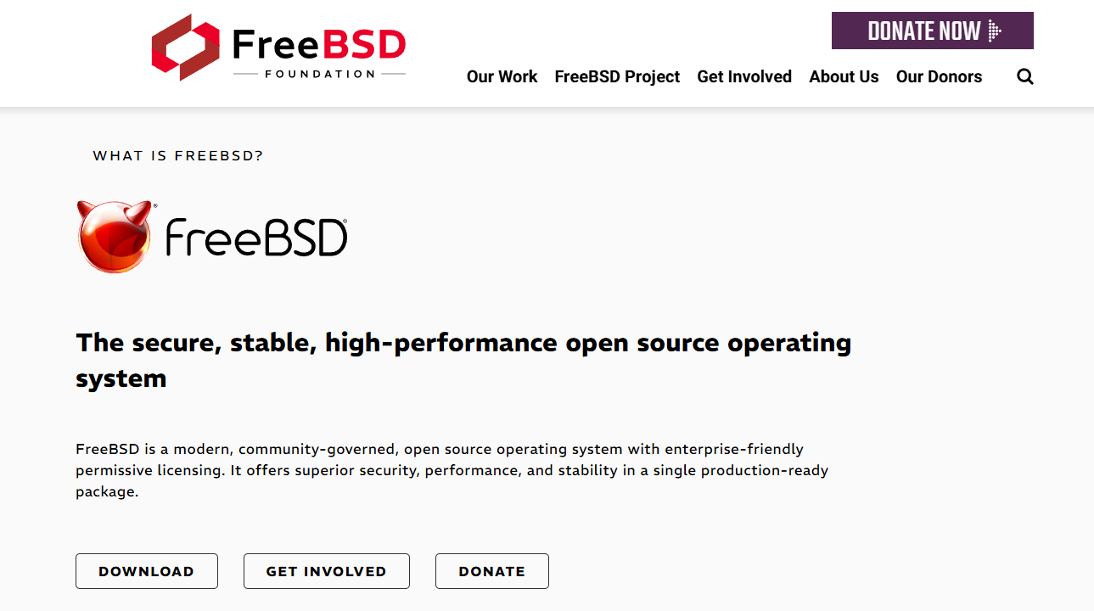

Slide 41
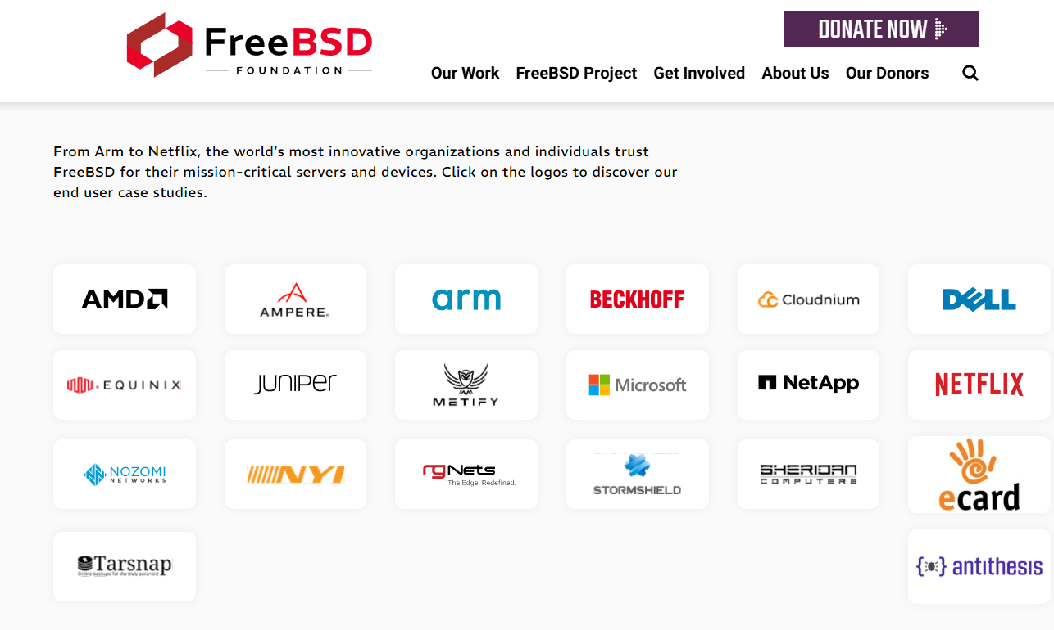

Slide 42
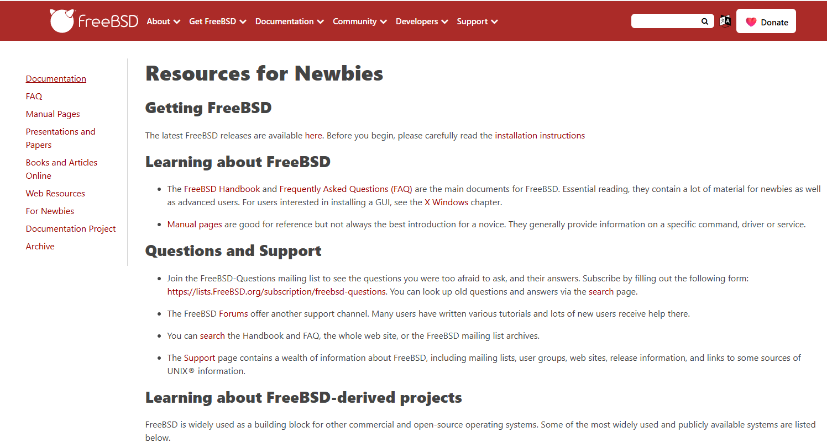

Slide 43
Primary features
Security
Services designed for minimal privilege
Single repository, single project
Security Team
Perfomance
Lightweight and scalable
ZFS
TCP/IP stack
Stability
Complete o/s, kernel, device drivers, userland and documentation

Slide 44
FreeBSD Release Strategy
RELEASE
Production ready fully supported
STABLE
Weekly snapshots of pre-release images
CURRENT
Weekly snapshots testing bleeding edge development

Slide 45
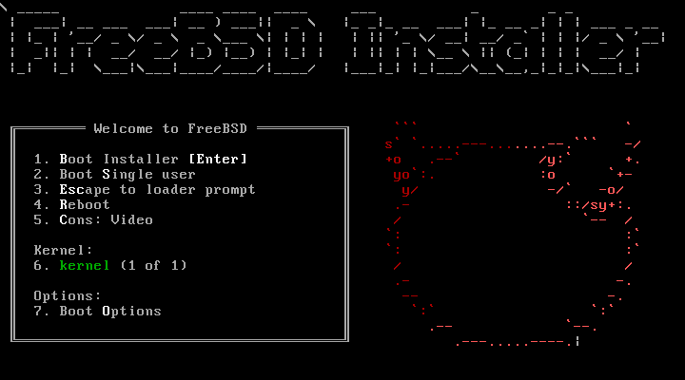
Booting install media

Slide 46
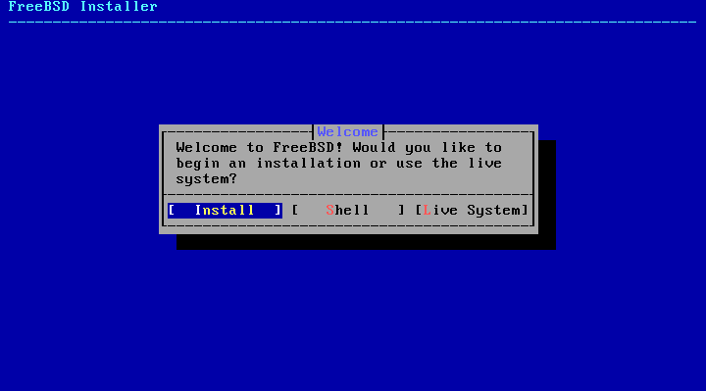

Slide 47
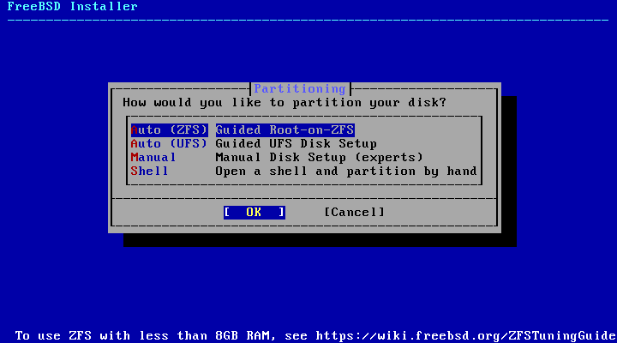

Slide 48
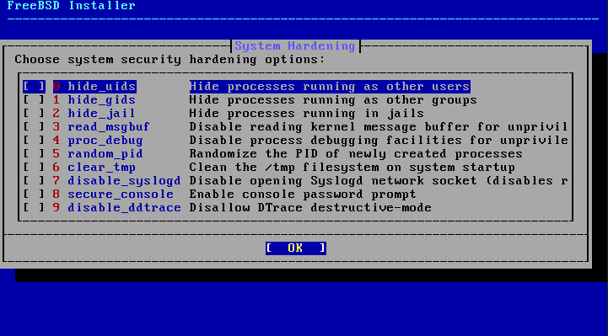
Tweek security settings

Slide 49
Adding applications
Two main methods exist
Packages
Very similar to Linux rpm, apt etc
Binary code along with whatever else is needed
Ports
Facility to compile from source
Includes linkages to dependencies etc
Allows customisation for the target

Slide 50
Send ‘em to Jail
Expands on chroot
Thick Jail – a complete fresh, separate base system
High isolation
Independent
Secure
But
High resource overhead
Individual maintennce

Slide 51
Send ‘em to Jail
Thin Jail – a minimal subset, separate base system
Resource efficiency
Rapid deployment
Unified maintenance
But
Reduced isolation
Some security concerns
Dependency conflicts

Slide 52
Send ‘em to Jail
Service jails
Linux jails
Vnet jails

Slide 53
The Z File System - ZFS
Developed at Sun, now the OpenZFS project
Natively integrated into FreeBSD
Data integrity – checksums all data
Pooled storage – can add fresh physical storage
High performance
memory based read cache - ARC
2nd level disk based read cache – L2ARC
Disk based synchronous write cache - ZIL

Slide 54
ZFS
Supports
Compression
Encryption
Deduplication
But
Memory intensive
Suggests 1GB ram for each 1TB of storage

Slide 55
Customise at will
Add “src” during installation
cd /usr/src/sys/config
cp GENERIC MYKERNEL
vi MYKERNEL (emacs if you must)
make config; make; make install

Slide 56
Why would I care?
Robust service platform
Web
Mail
Firewall
NAS / storage
Networking platform
Routing
VPN
IPSEC
Daily driver if doing more than just office knowledge worker

Slide 57
Why would I care?
Security is #1 focus
Security services
Firewall
VPN
ksh fan

Slide 58
Why would I care?
Support an odd CPU
Bring unix like o/s to an embedded system
Dare to be different?

Slide 59
Give a BSD a go
Expand your horizons

